Slide 1

Group 7 Library Application
Jeffery metz - 111435
Osama Quttriyeh – 617575
Hoang tin Nguyen - 618682

Slide 2
Use case diagram

Slide 3
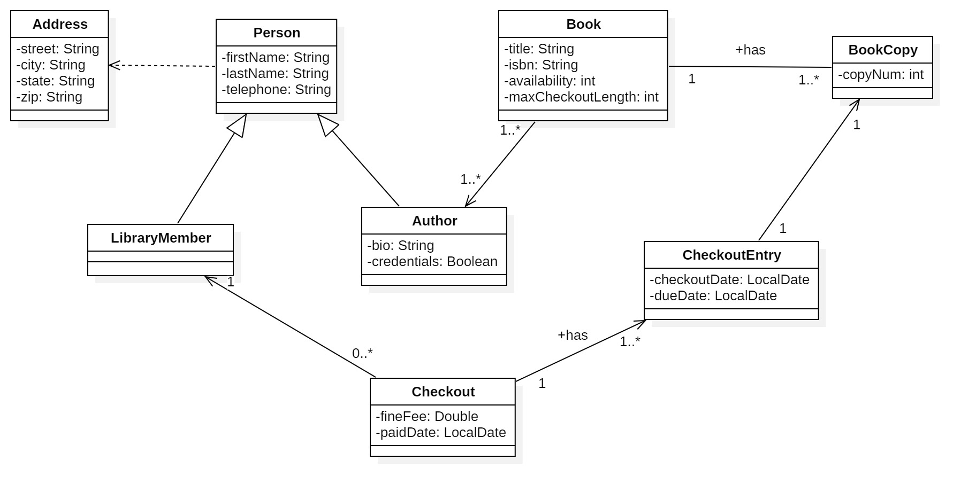
Class diagram

Slide 4
Sequence diagram 1

Slide 5
Sequence diagram 2

Slide 6
Sequence diagram 3

Slide 7
Demo
JDK 22
IDE: IntelliJ
https://github.com/venturousman/miu-mpp-library

Slide 8

Thanks for listening
This Photo by Unknown Author is licensed under CC BY-SA

Slide 9

Q&A
This Photo by Unknown Author is licensed under CC BY-NC

